Slide 1
LED MATRIX DISPLAY
GROUP 17

Slide 2
Functionality
Major function of LED matrix is to display information and messages(that includes characters, symbols, numbers, pattern etc.). It can be done by controlling electricity flow through each row and column of the matrix.

Slide 3
APPLICATIONS
LED arrays (composed of LED lamps, chip LEDs, etc.)
LED video screens
Moving message panels

Slide 4
COMPONENTS
200 LEDs
3 x 74HC595 shift registers
24 resistors
8 x 1k resistors
8 x 2N3904 transistors
1 x 4017 decade counter
1 x Arduino board or Atmega 328 chip.

Slide 5
WORKING

Slide 6
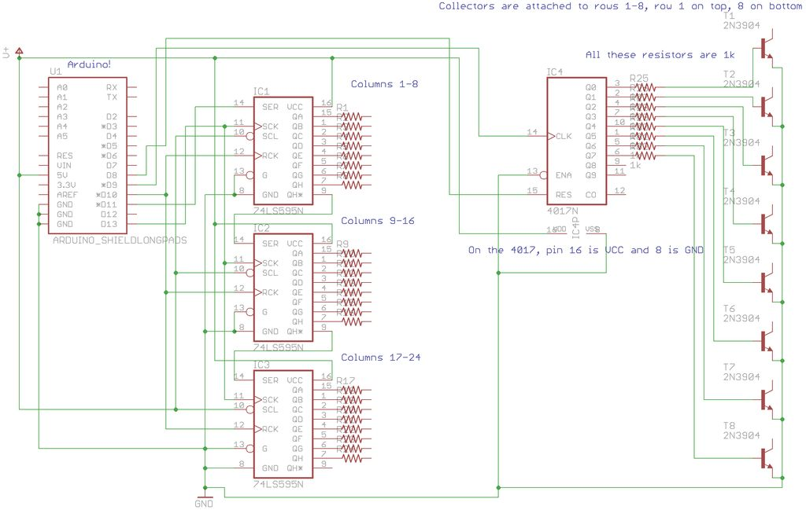

Slide 7
THANK YOU

